Slide 1

Advanced Analytical Theory and Methods: Association Rules
Author : FU
Date : Mar-2022

Slide 2
Objectives
After studying this chapter, the student should be able to understand key concepts:
Association rules
Apriori algorithm
Support
Confidence
Lift
Leverage

Slide 3
Content
Overview of Association Rules
Apriori Algorithm
Evaluation of Candidate Rules
Applications of Association Rules
An Example: Transactions in a Grocery Store
Validation and Testing
Diagnostics

Slide 4
1. Overview of Association Rules (1)
Given a large collection of transactions
each transaction consists of one or more items,
association rules go through the items being purchased to see what items are frequently bought together and to discover a list of rules that describe the purchasing behavior
FIGURE 5-1 The general logic behind association rules

Slide 5
1. Overview of Association Rules (2)
Goal is to discover interesting relationships among the items
Interesting relationships depend both on the business context and nature of the algorithm being used for the discovery
The uncovered rules is in the form X → Y, meaning that when item X is observed, item Y is also observed. The left-hand side (LHS) of the rule is X, and the right-hand side (RHS) of the rule is Y.
Using association rules, patterns discovered from the data that allow association rule algorithms to disclose rules of related product purchases.
First three uncovered rules listed in Figure 5-1 suggest that
when cereal is purchased, 90% of the time milk is purchased also.
When bread is purchased, 40% of the time milk is purchased also.
When milk is purchased, 23% of the time cereal is also purchased.

Slide 6
1. Overview of Association Rules (3)
Association rules sometimes referred to as market basket analysis because of their popularity in mining customer transactions
itemset refers to a collection of items or individual entities that contain some kind of relationship.
An itemset: Each transaction can be viewed as shopping basket of a customer that contains one or more items.
a k-itemset: An itemset containing k items.
This could be a set of retail items purchased together in one transaction,
a set of hyperlinks clicked on by one user in a single session,
or a set of tasks done in one day.
Use {item 1,item 2,. . . item k} to denote a k-itemset. Computation of the association rules is typically based on itemsets.

Slide 7
1. Overview of Association Rules (4)
Research started early 1960s. Hájek et al. introduced many of the key concepts and approaches of association rule learning, but it focused on the mathematical representation rather than the algorithm
Framework of association rule learning was brought into the database community by Agrawal et al in early 1990s for discovering regularities between products in a large database of customer transactions recorded by point-of-sale systems in supermarkets.
Apriori is one of the earliest and the most fundamental algorithms for generating association rules. It uses support for pruning the itemsets and controlling the exponential growth of candidate itemsets.
Shorter candidate itemsets (frequent itemsets) are combined and pruned to generate longer frequent itemsets. This approach eliminates the need for all possible itemsets to be enumerated within the algorithm, since the number of all possible itemsets can become exponentially large.

Slide 8
1. Overview of Association Rules (5)
support is one major component of Apriori. Given an itemset L, support of L is percentage of transactions that contain L.
For example, if 80% of all transactions contain itemset {bread}, then support of {bread} is 0.8. Similarly, if 60% of all transactions contain itemset {bread,butter}, then the support of {bread,butter} is 0.6.
A frequent itemset has items that appear together often enough. term “often enough” is formally defined with a minimum support criterion.
If the minimum support is set at 0.5, any itemset can be considered a frequent itemset if at least 50% of the transactions contain this itemset. In other words, support of a frequent itemset should be greater than or equal to the minimum support.
For the previous example, both {bread} and {bread,butter} are considered frequent itemsets at the minimum support 0.5. If minimum support is 0.7, only {bread} is considered a frequent itemset.

Slide 9
1. Overview of Association Rules (6)
Apriori property (or downward closure property): If an itemset is considered frequent, then any subset of the frequent itemset must also be frequent.
For example, if 60% of the transactions contain {bread,jam}, then at least 60% of all the transactions will contain {bread} or {jam}.
When the support of {bread,jam} is 0.6, support of {bread} or {jam} is at least 0.6 (Figure 5-2 illustrates how the Apriori property works)
If itemset {B,C,D} is frequent, then all the subsets of this itemset must also be frequent itemsets. Apriori property provides the basis for the Apriori algorithm.
Notes:
downward closure property: Thuộc tính đóng dưới

Slide 10
1. Overview of Association Rules (7)
FIGURE 5-2 Itemset {A,B,C,D} and its subsets

Slide 11
2 Apriori Algorithm (1)
Takes a bottom-up iterative approach to uncovering frequent itemsets by
first determining all the possible items (or 1-itemsets, for example {bread}, {eggs}, {milk}, …)
and then identifying which among them are frequent
Assuming minimum support threshold (or the minimum support criterion) is set at 0.5, algorithm identifies and retains those itemsets that appear in at least 50% of all transactions and discards (or “prunes away”) itemsets that have a support less than 0.5 or appear in fewer than 50% of the transactions.
In the next iteration of the Apriori algorithm, identified frequent 1-itemsets are paired into 2-itemsets (for example, {bread,eggs}, {bread,milk}, {eggs,milk}, …) and again evaluated to identify the frequent 2-itemsets among them.
Notes:
The word prune is used like it would be in gardening, where unwanted branches of a bush are clipped away

Slide 12
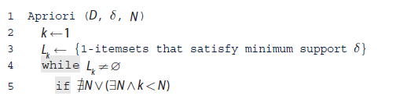
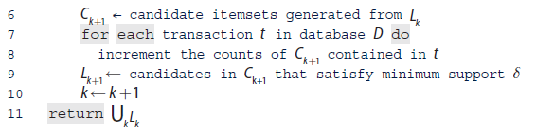
2 Apriori Algorithm (2)
At each iteration, algorithm checks whether the support criterion can be met; if it can, algorithm grows the itemset, repeating the process until it runs out of support or until the itemsets reach a predefined length.
Example Let variable C_{k} be set of candidate k-itemsets and
L_{k} be the set of k-itemsets that satisfy the minimum support.
D is given a transaction database
δ is a minimum support threshold,
N is an optional parameter indicating the maximum length an itemset could reach,
Apriori iteratively computes frequent itemsets L_{k+1} based on L_{k}.

Slide 13
2 Apriori Algorithm (3)
First step, Identify frequent itemsets by starting with each item in the transactions that meets the predefined minimum support threshold δ. These itemsets are 1-itemsets noted as L1, as each 1-itemset contains only one item.
Next, grows itemsets by joining L1 onto itself to form new, grown 2-itemsets denoted as L2 and determines the support of each 2-itemset in L2.
Those itemsets that do not meet the minimum support threshold δ are pruned away. Growing and pruning process is repeated until no itemsets meet the minimum support threshold.
Optionally, a threshold N can be set up to specify the maximum number of items the itemset can reach or the maximum number of iterations of the algorithm.
Once completed, output of the Apriori algorithm is the collection of all the frequent k-itemsets.
Next, a collection of candidate rules is formed based on the frequent itemsets uncovered in iterative process described earlier. For example, a frequent itemset {milk,eggs} may suggest candidate rules {milk}→{eggs} and {eggs}→{milk}.

Slide 14

3 Evaluation of Candidate Rules (1)
Confidence is defined as the measure of certainty or trustworthiness associated with each discovered rule. (see Equation 5-1).
Example
if {bread,eggs,milk} has a support of 0.15 and {bread,eggs} has a support of 0.15, confidence of rule {bread,eggs}→{milk} is 1 → Means 100% of the time a customer buys bread and eggs, milk is bought. Rule is correct for 100% of the transactions containing bread and eggs.

Slide 15
3 Evaluation of Candidate Rules (2)
Minimum confidence: predefined threshold when a relationship may be interesting when algorithm identifies the relationship with a measure of confidence greater than or equal to a predefined threshold.
Apriori algorithm uses two common measure: support and confidence. All the rules can be ranked based on these two measures to filter out the uninteresting rules and retain the interesting ones.

Slide 16

3 Evaluation of Candidate Rules (3)
Confidence can identify the interesting rules from all the candidate rules, it comes with a problem.
Lift measures how many times more often X and Y occur together than expected if they are statistically independent of each other. Lift is a measure of how X and Y are really related rather than coincidentally happening together (see Equation 5-2).
Leverage is a similar notion, but instead of using a ratio, leverage uses the difference (see Equation 5-3).

Slide 17
4 Applications of Association Rules
Market basket analysis refers to a specific implementation of association rules mining that many companies use for a variety of purposes, including these:
Broad-scale approaches to better merchandising—what products should be included in or excluded from the inventory each month
Cross-merchandising between products and high-margin or high-ticket items
Physical or logical placement of product within related categories of products
Promotional programs—multiple product purchase incentives managed through a loyalty card program
Association rules are also commonly used for recommender systems and clickstream analysis
Amazon and Netflix use recommender systems implement this. Recommender systems can use association rules to discover related products or identify customers who have similar interests

Slide 18
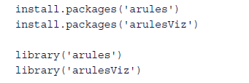
5 An Example: Transactions in a Grocery Store
Using R and the arules and arulesViz packages, this example shows how to use the Apriori algorithm to generate frequent itemsets and rules and to evaluate and visualize the rules
Commands install these two packages and import them into the current R workspace:

Slide 19
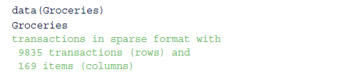
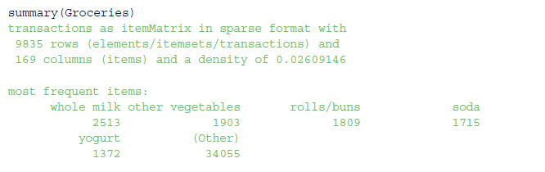
5.1 The Groceries Dataset (1)
Groceries dataset is collected from 30 days of real-world point-of-sale transactions of a grocery store. dataset contains9,835 transactions, and the items are aggregated into 169 categories.
Summary shows that the most frequent items in the dataset include items such as whole milk, other vegetables, rolls/buns, soda, and yogurt. These items are purchased more often than the others.

Slide 20
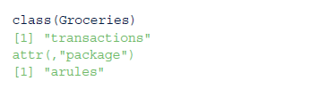
5.1 The Groceries Dataset (2)
transactions class defined by the arules package contains three slots:
transactionInfo: A data frame with vectors of the same length as the number of transactions
itemInfo: A data frame to store item labels
data: A binary incidence matrix that indicates which item labels appear in every transaction

Slide 21
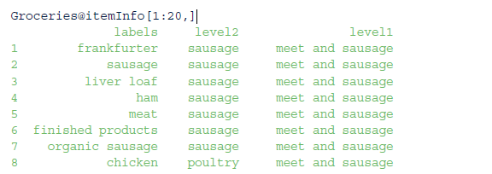
5.1 The Groceries Dataset (3)
For Groceries dataset, transactionInfo is not being used. Enter Groceries@itemInfo to display all 169 grocery labels as well as their categories.
Following command displays only the first 20 grocery labels.
Each grocery label is mapped to two levels of categories— level2 and level1—where level1 is a superset of level2.
Ex: grocery label sausage belongs to the sausage category in level2, and it is part of the meat and sausage category in level1. (Note that “meet” in level1 is a typo in the dataset.)

Slide 22

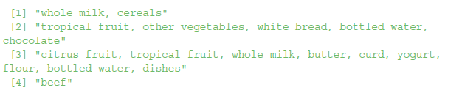
5.1 The Groceries Dataset (4)
Following code displays the 10th to 20th transactions of the Groceries dataset. The [10:20] can be changed to [1:9835] to display all the transactions.
Each row in the output shows a transaction that includes one or more products, and each transaction corresponds to everything in a customer’s shopping cart.
For example, in the first transaction, a customer has purchased whole milk and cereals.

Slide 23
5.2 Frequent Itemset Generation (1)
apriori() function in arule package implements the Apriori algorithm to create frequent itemsets.
by default, apriori() function executes all the iterations at once.
Code examples in this section manually set the parameters of apriori() function to simulate each iteration of the algorithm illustrate how the Apriori algorithm works.
Assume that minimum support threshold is set to 0.02 based on management discretion. Because dataset contains 9,853 transactions, an itemset should appear at least 198 times to be considered a frequent itemset.
First iteration of the Apriori algorithm computes support of each product in dataset and retains those products that satisfy the minimum support.
The following code identifies 59 frequent 1-itemsets that satisfy the minimum support.
parameters of apriori() pecify the minimum and maximum lengths of the itemsets, the minimum support threshold, and the target indicating the type of association mined.

Slide 24
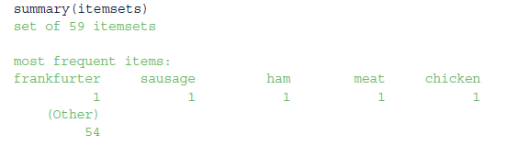
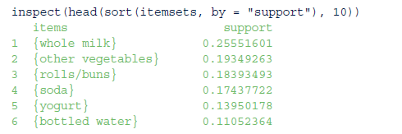
5.2 Frequent Itemset Generation (2)
summary(itemsets) shows support of 1-itemsets ranges from 0.02105 to 0.25552.
Because maximum support of the 1-itemsets in the dataset is only 0.25552, to enable discovery of interesting rules, the minimum support threshold should not be set too close to that number.
inspect() function to display top 10 frequent 1-itemsets sorted by their support.
Of all the transaction records, the 59 1-itemsets such as {whole milk}, {other vegetables}, {rolls/buns}, {soda}, and {yogurt} all satisfy the minimum support.
Therefore, they are called frequent 1-itemsets.

Slide 25

5.2 Frequent Itemset Generation (3)
In the next iteration, list of frequent 1-itemsets is joined onto itself to form all possible candidate 2-itemsets.
For example, 1-itemsets {whole milk} and {soda} would be joined to become a 2-itemset {whole milk,soda}.
Algorithm computes the support of each candidate 2-itemset and retains those that satisfy the minimum support.
output that follows shows that 61 frequent 2-itemsets have been identified.
summary of the itemsets shows that the support of 2-itemsets ranges from 0.02003 to 0.07483.

Slide 26
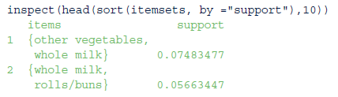
5.2 Frequent Itemset Generation (4)
Top 10 most frequent 2-itemsets are displayed next, sorted by their support. Notice that whole milk appears six times in the top 10 2-itemsets ranked by support.
As seen earlier, {whole milk} has the highest support among all the 1-itemsets. These top 10 2-itemsets with the highest support may not be interesting; this highlights the limitations of using support alone.
Next, list of frequent 2-itemsets is joined onto itself to form candidate 3-itemsets.
For example {other vegetables, whole milk} and {whole milk,rolls/buns} would be joined as {other vegetables, whole milk, rolls/buns}.
The algorithm retains those itemsets that satisfy the minimum support. The following output shows that only two frequent 3-itemsets have been identified.
3-itemsets are displayed next:

Slide 27
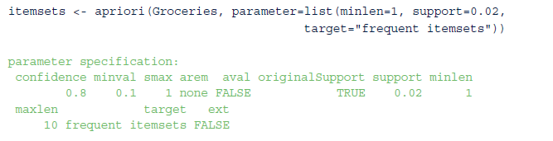
5.2 Frequent Itemset Generation (5)
In the next iteration, there is only one candidate 4-itemset {root vegetables,other vegetables,whole milk,yogurt}, and its support is below 0.02. No frequent 4-itemsets have been found, and the algorithm converges.
When the maxlen parameter is not set, the algorithm continues each iteration until it runs out of support or until k reaches the default maxlen=10.

Slide 28

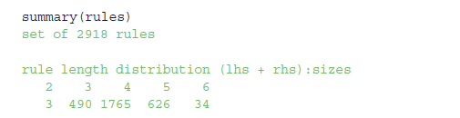
5.3 Rule Generation and Visualization (1)
apriori() function can be used to generate rules. Assume that minimum support threshold is now set to a lower value 0.001, and minimum confidence threshold is set to 0.6.
A lower minimum support threshold allows more rules to show up.
Following code creates 2,918 rules from all the transactions in the Groceries dataset that satisfy both the minimum support and the minimum confidence.
summary of the rules shows the number of rules and ranges of the support, confidence, and lift.

Slide 29
5.3 Rule Generation and Visualization (2)
plot(rules) display the scatterplot of the 2,918 rules (Figure 5-3),
scatterplot shows that 2,918 rules generated from the Groceries dataset, the highest lift occurs at a low support and a low confidence.
FIGURE 5-3 Scatterplot of the 2,918 rules with minimum support 0.001 and minimum confidence 0.6

Slide 30

5.3 Rule Generation and Visualization (3)
plot(rules@quality) displays a scatterplot matrix (Figure 5-4) to compare the support, confidence, and lift of the 2,918 rules.
Figure 5-4 shows that lift is proportional to confidence and illustrates several linear groupings. As indicated by Equation 5-2 and Equation 5-3, Lift=Confidence / Support(Y).
Therefore, when the support of Y remains the same, lift is proportional to confidence, and the slope of the linear trend is the reciprocal of Support(Y).
Following code shows that, of the 2,918 rules, only 18 different values for 1/Support(Y), and majority occurs at slopes 3.91, 5.17, 7.17, 9.17, and 9.53. This matches the slopes shown in the third row and second column of Figure 5-4, where the x-axis is the confidence and the y-axis is the lift.
FIGURE 5-4 Scatterplot matrix on the support, confidence, and lift of the 2,918 rules

Slide 31


5.3 Rule Generation and Visualization (4)
inspect() function can display content of the rules generated previously. The following code shows the top ten rules sorted by the lift. Rule {Instant food products,soda}→{hamburger meat} has the highest lift of 18.995654.
code fetches a total of 127 rules whose confidence is above 0.9:
Command produces a matrix-based visualization (Figure 5-5) of the LHS versus the RHS of the rules. The legend on the right is a color matrix indicating the lift and the confidence to which each square in the main matrix corresponds.

Slide 32

5.3 Rule Generation and Visualization (5)
As the previous plot() command runs, the R console would simultaneously display a distinct list of the LHS and RHS from the 127 rules. A segment of the output is shown here:
FIGURE 5-5 Matrix-based visualization of LHS and RHS, colored by lift and confidence

Slide 33

5.3 Rule Generation and Visualization (6)
plot is shown in Figure 5-6. In the graph, the arrow always points from an item on the LHS to an item on the RHS.
E.g arrows that connect ham, processed cheese, and white bread suggest rule {ham,processed cheese}→{white bread}.
legend on the top right of the graph shows that the size of a circle indicates the support of the rules ranging from 0.001 to 0.002. The color (or shade) represents the lift, which ranges from 11.279 to 18.996.
rule with the highest lift is {Instant food products,soda} → {hamburger meat}.
FIGURE 5-6 Graph visualization of the top five rules sorted by lift

Slide 34
6 Validation and Testing (1)
Established through statistical measures such as confidence, lift, and leverage. Rules that involve mutually independent items or cover few transactions are considered uninteresting because they may capture spurious relationships
Confidence measures the chance that X and Y appear together in relation to the chance X appears. Confidence can be used to identify the interestingness of the rules.
Lift and leverage both compare the support of X and Y against their individual support. While mining data with association rules, some rules generated could be purely coincidental.
For example, if 95% of customers buy X and 90% of customers buy Y, then X and Y would occur together at least 85% of the time, even if there is no relationship between the two. Measures like lift and leverage ensure that interesting rules are identified rather than coincidental ones.

Slide 35
6 Validation and Testing (2)
Another set of criteria can be established through subjective arguments. Even with a high confidence, a rule may be considered subjectively uninteresting unless it reveals any unexpected profitable actions.
For example, rules like {paper}→{pencil} may not be subjectively interesting or meaningful despite high support and confidence values.
In contrast, a rule like {diaper}→{beer} that satisfies both minimum support and minimum confidence can be considered subjectively interesting because this rule is unexpected and may suggest a cross-sell opportunity for the retailer.
This incorporation of subjective knowledge into the evaluation of rules can be a difficult task, and it requires collaboration with domain experts

Slide 36
7 Diagnostics (1)
Some of the rules generated are uninteresting or practically useless.
Some of the rules may be generated due to coincidental relationships between the variables. Measures like confidence, lift, and leverage should be used along with human insights to address this problem.
Another problem: in Phase 3 and 4 of the Data Analytics Lifecycle, team must specify the minimum support prior to the model execution, which may lead to too many or too few rules
Apriori algorithm reduces the computational workload by only examining itemsets that meet the specified minimum threshold. However, depending on the size of thedataset, Apriori algorithm can be computationally expensive.
For each level of support, the algorithm requires a scan of the entire database to obtain the result. Accordingly, as the database grows, it takes more time to compute in each run

Slide 37
7 Diagnostics (2)
Some approaches to improve Apriori’s efficiency
Partitioning: Any itemset that is potentially frequent in a transaction database must be frequent in at least one of the partitions of the transaction database
Sampling: This extracts a subset of the data with a lower support threshold and uses the subset to perform association rule mining
Transaction reduction: A transaction that does not contain frequent k-itemsets is useless in subsequent scans and therefore can be ignored.
Hash-based itemset counting: If the corresponding hashing bucket count of a k-itemset is below a certain threshold, the k-itemset cannot be frequent
Dynamic itemset counting: Only add new candidate itemsets when all of their subsets are estimated to be frequent.

Slide 38
Summary
As an unsupervised analysis technique that uncovers relationships among items, association rules find many uses in activities, including market basket analysis, clickstream analysis, and recommendation engines.
Although association rules are not used to predict outcomes or behaviors, they are good at identifying “interesting” relationships within items from a large dataset. Quite often, the disclosed relationships that the association rules suggest do not seem obvious; they, therefore, provide valuable insights for institutions to improve their business operations.
Apriori algorithm is one of the earliest and most fundamental algorithms for association rules.
Used a grocery store example to walk through the steps of Apriori and generate frequent k-itemsets and useful rules for downstream analysis and visualization.
A few measures such as support, confidence, lift, and leverage were discussed. These measures together help identify the interesting rules and eliminate the coincidental rules.
Finally, discussed some pros and cons of the Apriori algorithm and highlighted a few methods to improve its efficiency.

